Slide 1
A high-throughput and high-capacity IPv6 routing lookup system
Author: Yi-Mao Hsiao , Yuan-Sun Chu, Jeng-Farn Lee, Jinn-Shyan Wang
Publisher: journal computer networks,2012
Presenter: Jia-Wei,Yu
Date: 2012/12/12

Slide 2
Introduction
In this paper, we propose a high-throughput and high capacity routing lookup system. The system is a cache-centric, hash-based architecture with a memory set (RAMs) and a TCAM to resolve the problem of collisions caused by the hash function.
The routing lookup system approaches 260 Mlps, which is sufficient for 100 Gbps networks, and the routing table only needs 10.24 KB on-chip BCAM, 20.04 KB off-chip TCAM and 29.29 MB DRAM. It can support 3.6 M routing entries.

Slide 3
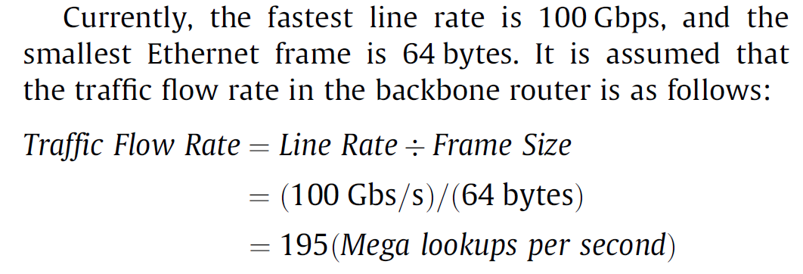

Slide 4
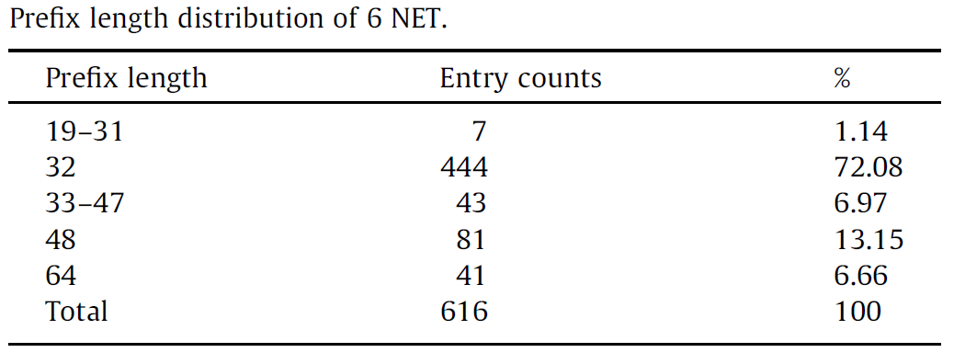
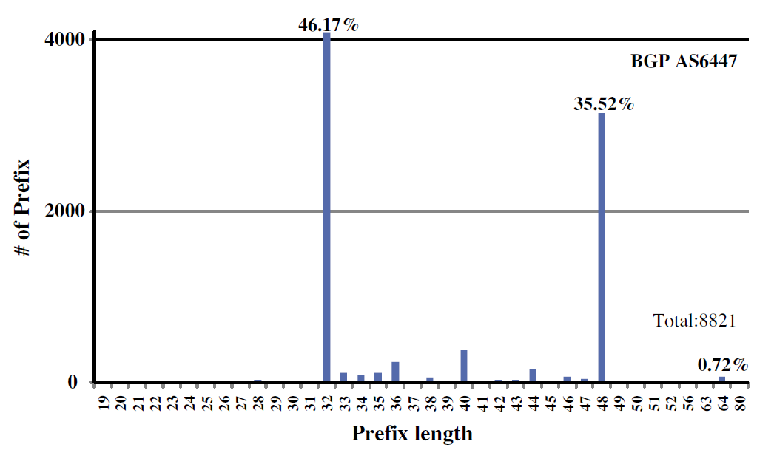

Slide 5
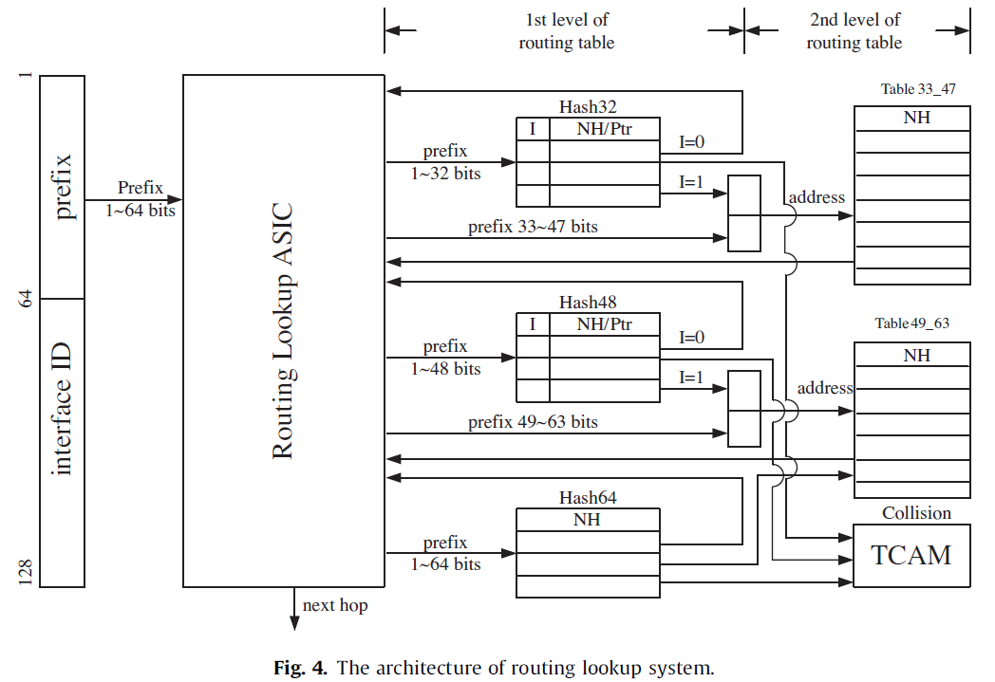
System architecture

Slide 6
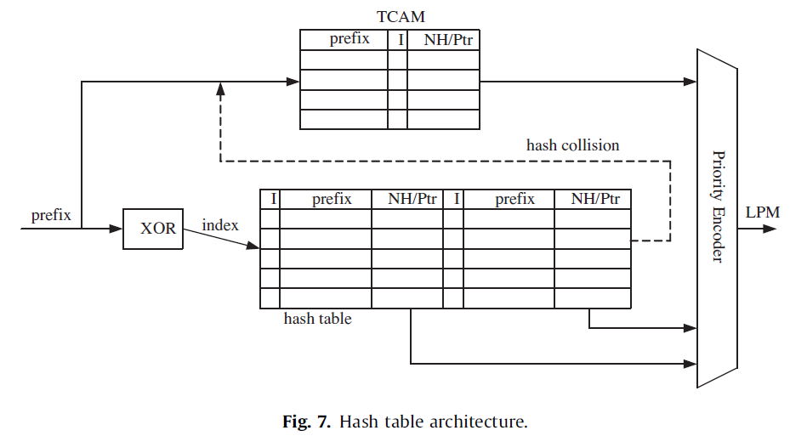
XOR folding

Slide 7
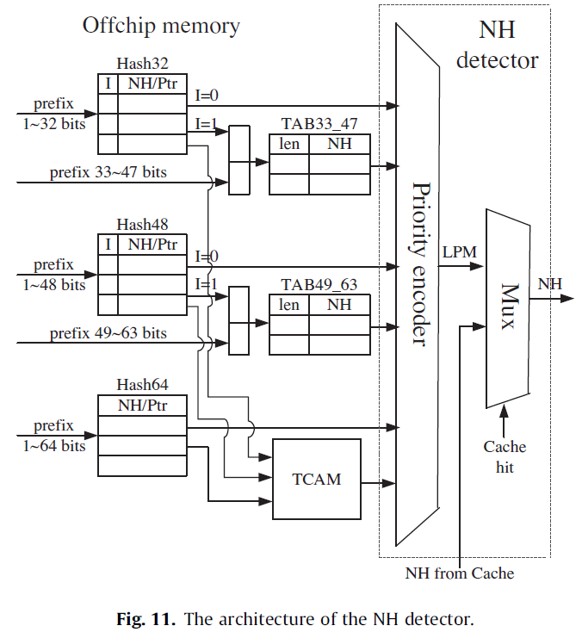

Slide 8
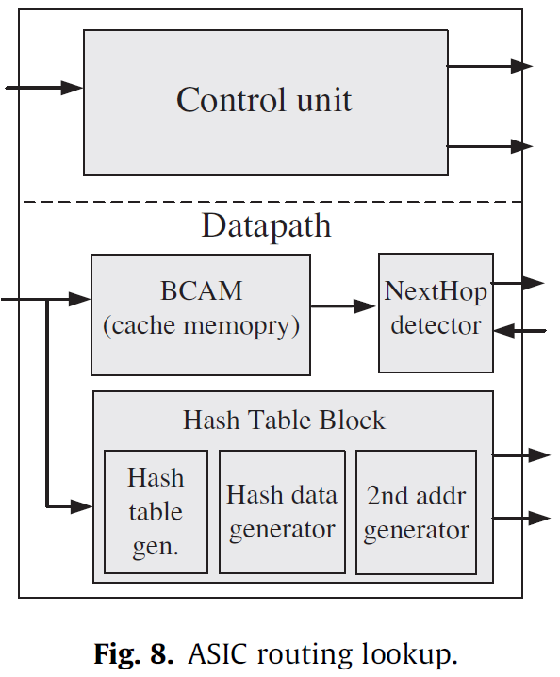

Slide 9
Cache

Slide 10
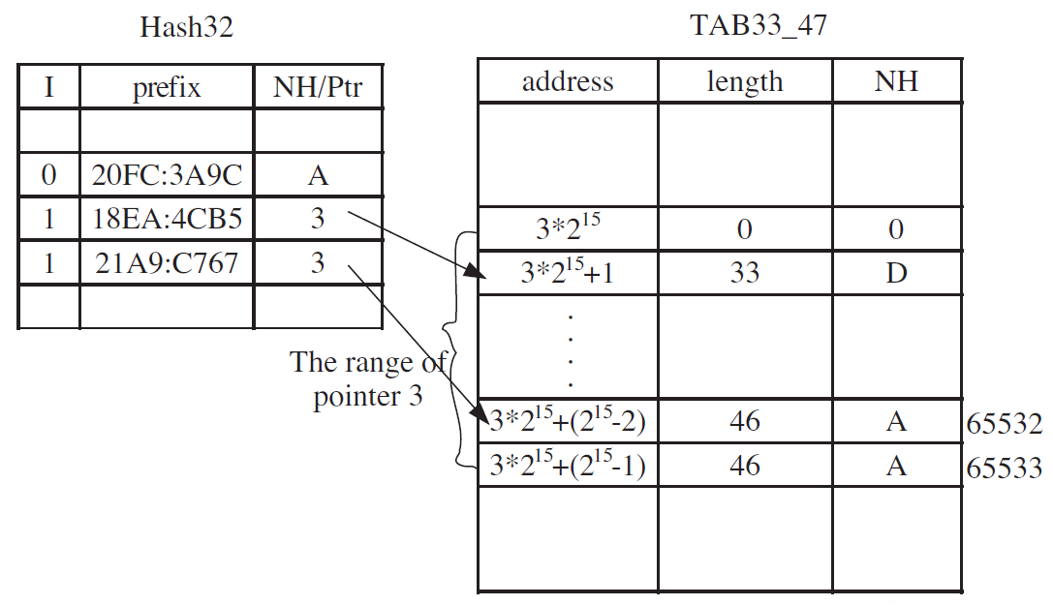
Search
Search : 20FC:3A9C:0:0:0:0:0:0 , 21A9:C767:FFFC:0:0:0:0:0

Slide 11
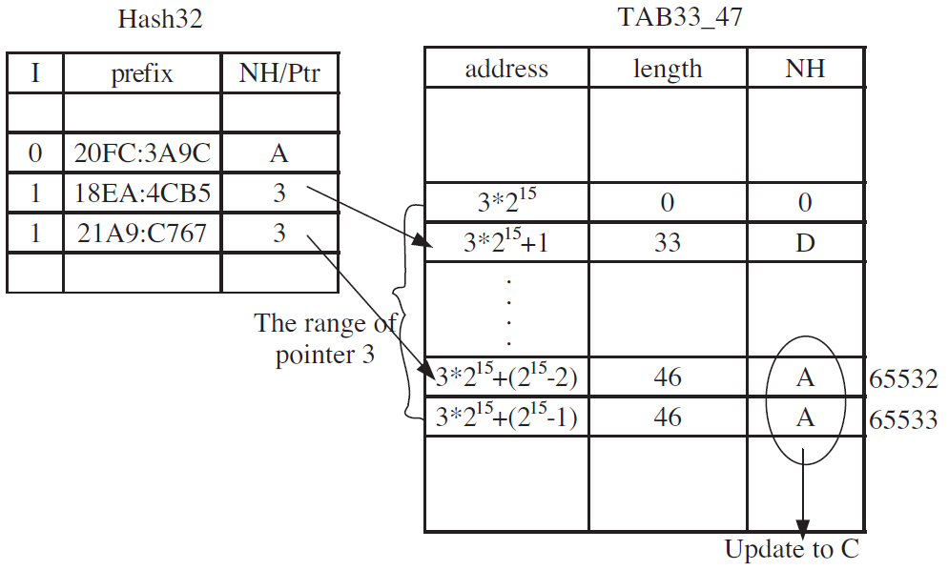
Update
Update : 21A9:C767:FFFC::/46 NH : C

Slide 12
Hash32 : $2^{18}$ , Hash48 : $2^{15}$ , Hash64 : $2^{14}$

Slide 13
Performance

Slide 14
